Slide 1

Welcome to:
Maker Training Session
5:30 PM Tuesday, January 23, 2017
Broun Hall, Room 235

Slide 2


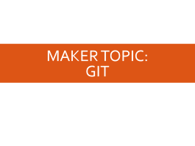

Agenda

Slide 3
About SPARC

Slide 4
Introduction
Student lead organization at Auburn University.
Creates and fosters an environment of creativity and innovation through collaborative projects.
A place to test out ideas, integrate concepts learned in class, and learn skills that will be instrumental when working in the workforce.
No prior experience is required, only a willingness to learn.
Great for students of all ages and majors.
President: Matthew Castleberry

Slide 5


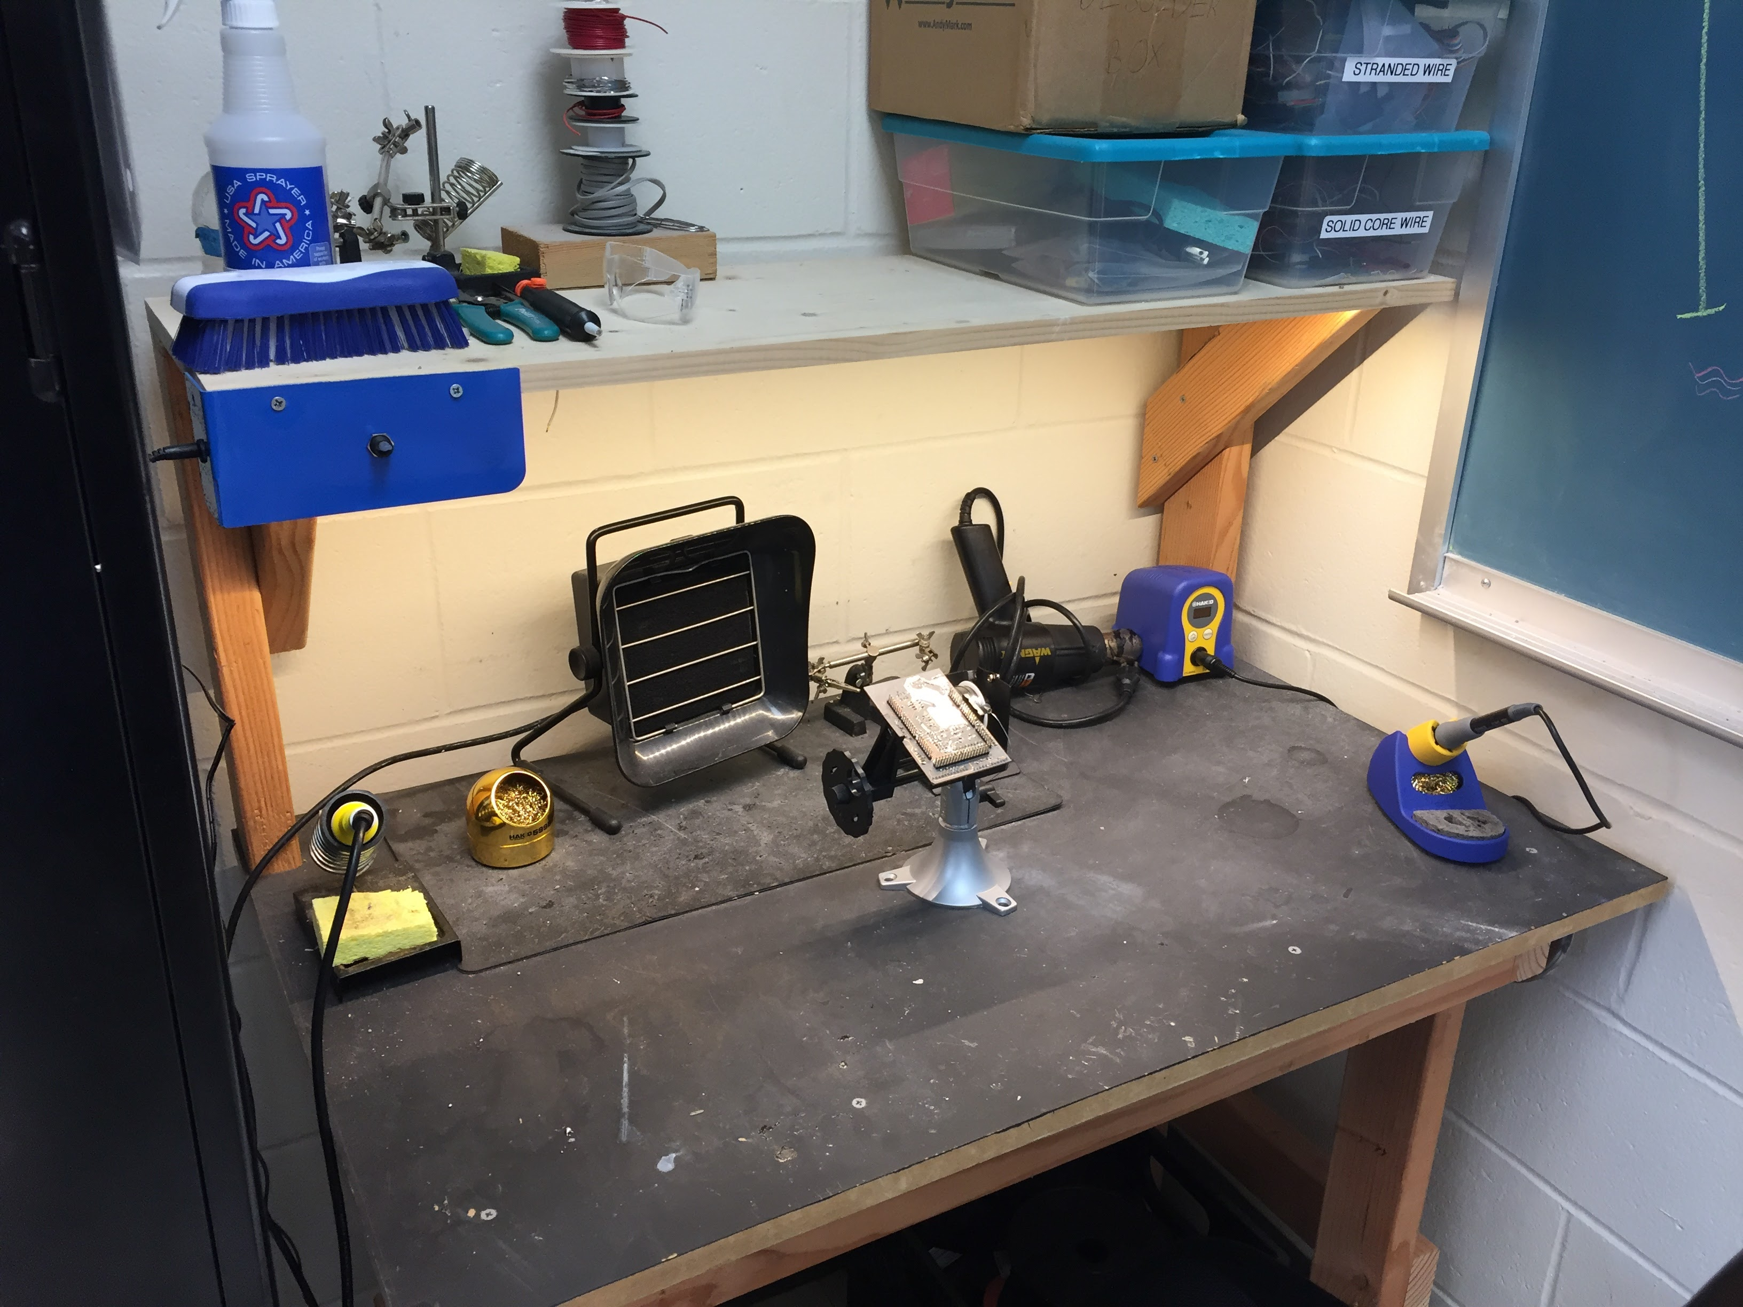
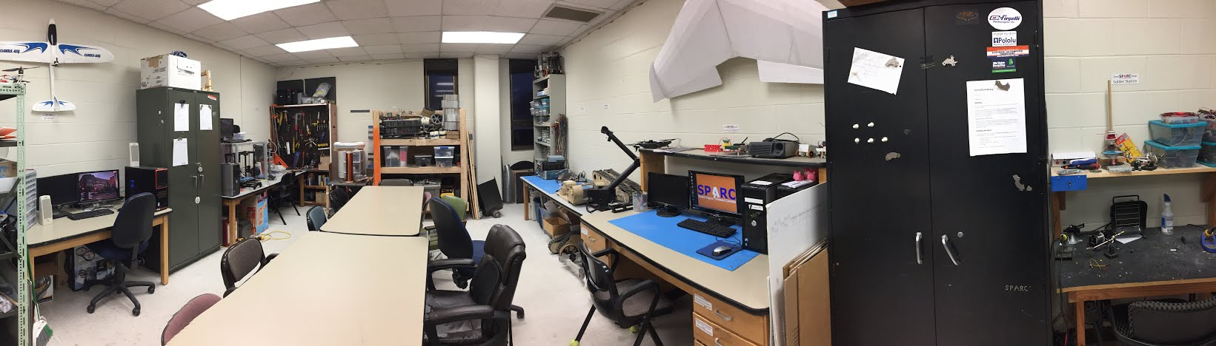
Our Lab
Broun Hall
Room: 367

Slide 6
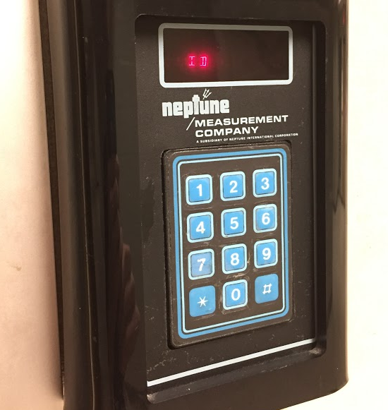
How to become a Member
Log 5 constructive hours in the lab
Write the times on the sheet on the clipboard next to the door.
Contact us at sparc.auburn@gmail.com
We will respond with the instructions to get an access code.

Slide 7
SPARC Meetings
Open Forum
Discuss status of active projects
Learn about and discuss specific topic in the realms of technology, engineering or making.
Wednesdays at 6:00 PM
Maker Training Session
Learn about a specific skills like 3D printing, CAD, electrical prototyping, and robotics.
Centered around SPARC Sumo Bot Competition
Tuesdays at 5:30 PM
Project Meetings
Project members come together to talk about detailed progress.
Meeting times and locations vary from project to project.

Slide 8



Partner Organizations
NASA Robotics Mining Competition Team
President: Jeremy Frasher <jjf0010@auburn.edu>
Meets on Mondays 6-7, SPARC Lab, Broun 367
RC Hobbyist Club
President: Craig Legrand <cbl0019@auburn.edu>
Meets on Mondays TBD and Fridays 3:30-5:00, Broun 235
IEEE Auburn University Student Branch
President: Michelle Kniffen <mek0027@auburn.edu>
Meets on Mondays 5:30-6:30, Broun 238

Slide 9




More Information about SPARC
Website
http://sparc-auburn.github.io/
Github
https://github.com/SPARC-Auburn
Slack
https://sparc-auburn.slack.com/
Email
sparc.auburn@gmail.com

Slide 10
Outreach

Slide 11
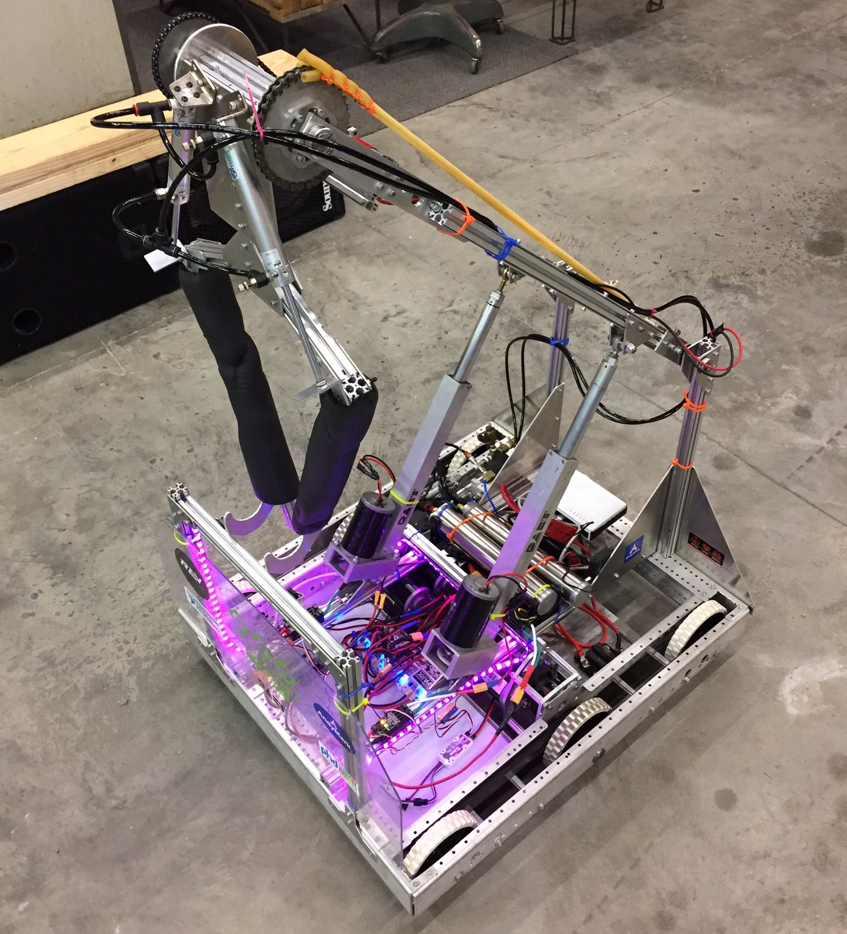
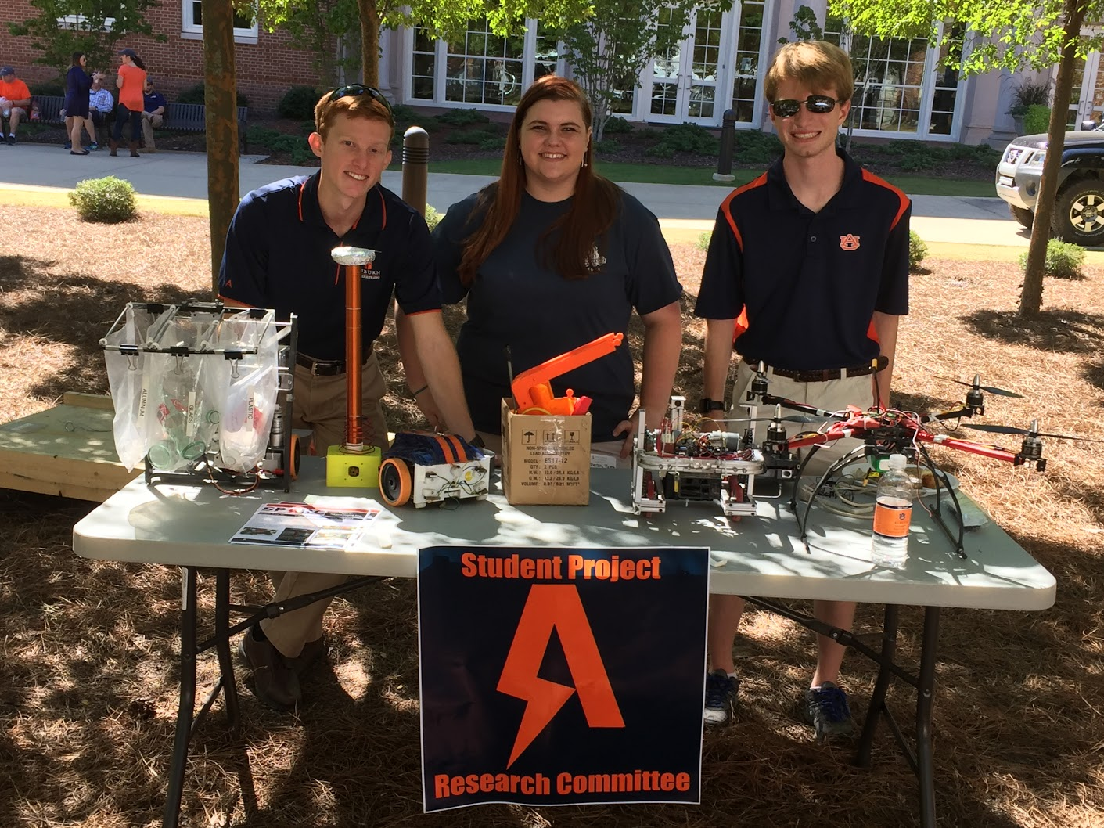
Outreach Events
Opelika HS FRC Team
Help mentor a FIRST Robotics Competition (FRC) Team
Mon Tue Thu: 3:30-6:30, Fri: 3:30-9:30, Sat:10-6
E-Day
Help display projects in Broun, Student Center, and Concourse to high school students.
Friday, February 23rd
Robot in 3 Days 2018 Bot
Engineering Tailgate 2016 SPARC Table
Notes:
Fall 2016
Loachapoka Robotics Mentoring- Mondays, Tuesdays, and Thursdays 3:00PM to 4:30PM
ECE Minority Presentation- November 14th
AJHS E-Day- November 17th
South’s Best- December 3-4th
SCORE Claw Machine- December 3-4th
Spring 2016
E-Day- Late February or early March
SPACE Day- Possible Event Next Semester
IEEE Sumo Robotics Competition (with local middle and high schools)- Spring 2017

Slide 12
Sumo Robotics Tournament

Slide 13
What is a Sumo Bot?

Slide 14
Maker Topic: Git

Slide 15
Why use Version Control System
Allows seamless collaboration on files
Provides a central location for files
Prevents loss of data by preventing overwriting
All changes are documented
If new bugs arise, files can be reverted back
Works with just about any file
Git is a VCS for software development
Repository
Version 1
Version 2
Version 3
commit
sync
commit
sync
commit
sync
User A
User B
User C

Slide 16

Definition of Terms
Repository (Master Branch)- a central location in which data is stored and managed.
Branch- an alternative version of the repository
Clone- copying of files from a repository into a local branch
Commit- push and pull from local branch to repository
Hotfix- a fix of a user specific bug

Slide 17

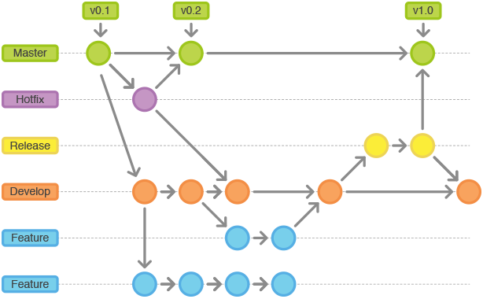
Git Work Flow

Slide 18
What is GitHub
GitHub is an online Git Version Control System for software developers.
Advertised as “social coding”
It is free, open source, and widely used.
Works well with Windows, Mac, and Linux (Including Raspberry Pi)
Is not limited to just software files.
SPARC projects and documents are highly integrated into GitHub

Slide 19
Ways to Use Git and Github
Basic (GUI)
GitKraken
SourceTree
GitHub Desktop
Advanced (Terminal/GitBash)
Use terminal Commands after installing git on operating system
Example Commands:
git clone /path/to/repository
git commit -m "Commit message"
git push origin master
git pull
More commands: https://git-scm.com/docs

Slide 20

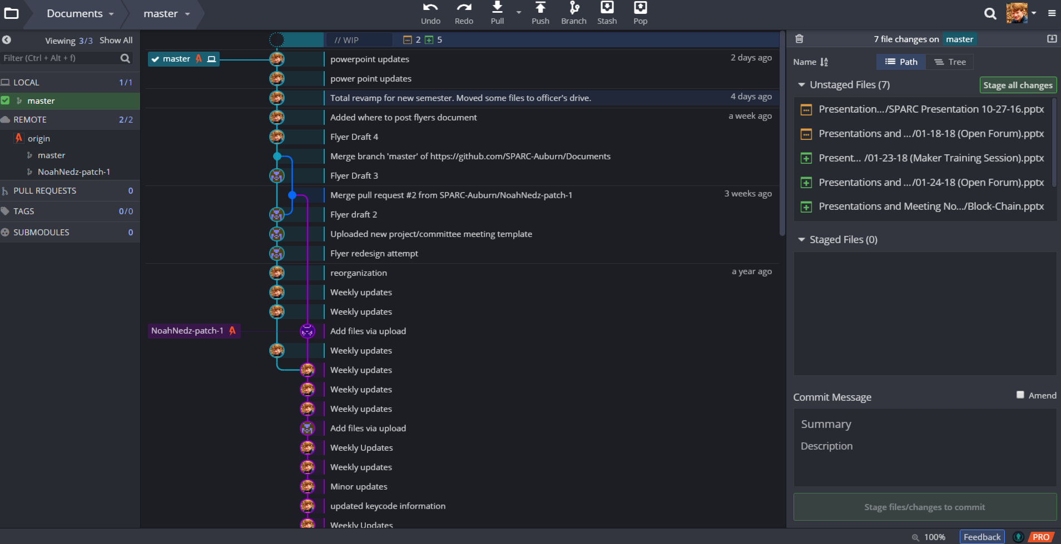
Using Git iN

